Slide 1
How to manage honest and challenging conversations
Agenda
What are difficult conversation & why do we hate them?
Examples of frequent topics
Line Manager practical hints and tips for effective outcomes
Scenario discussions and Q&A
JM Consulting Ltd

Slide 2
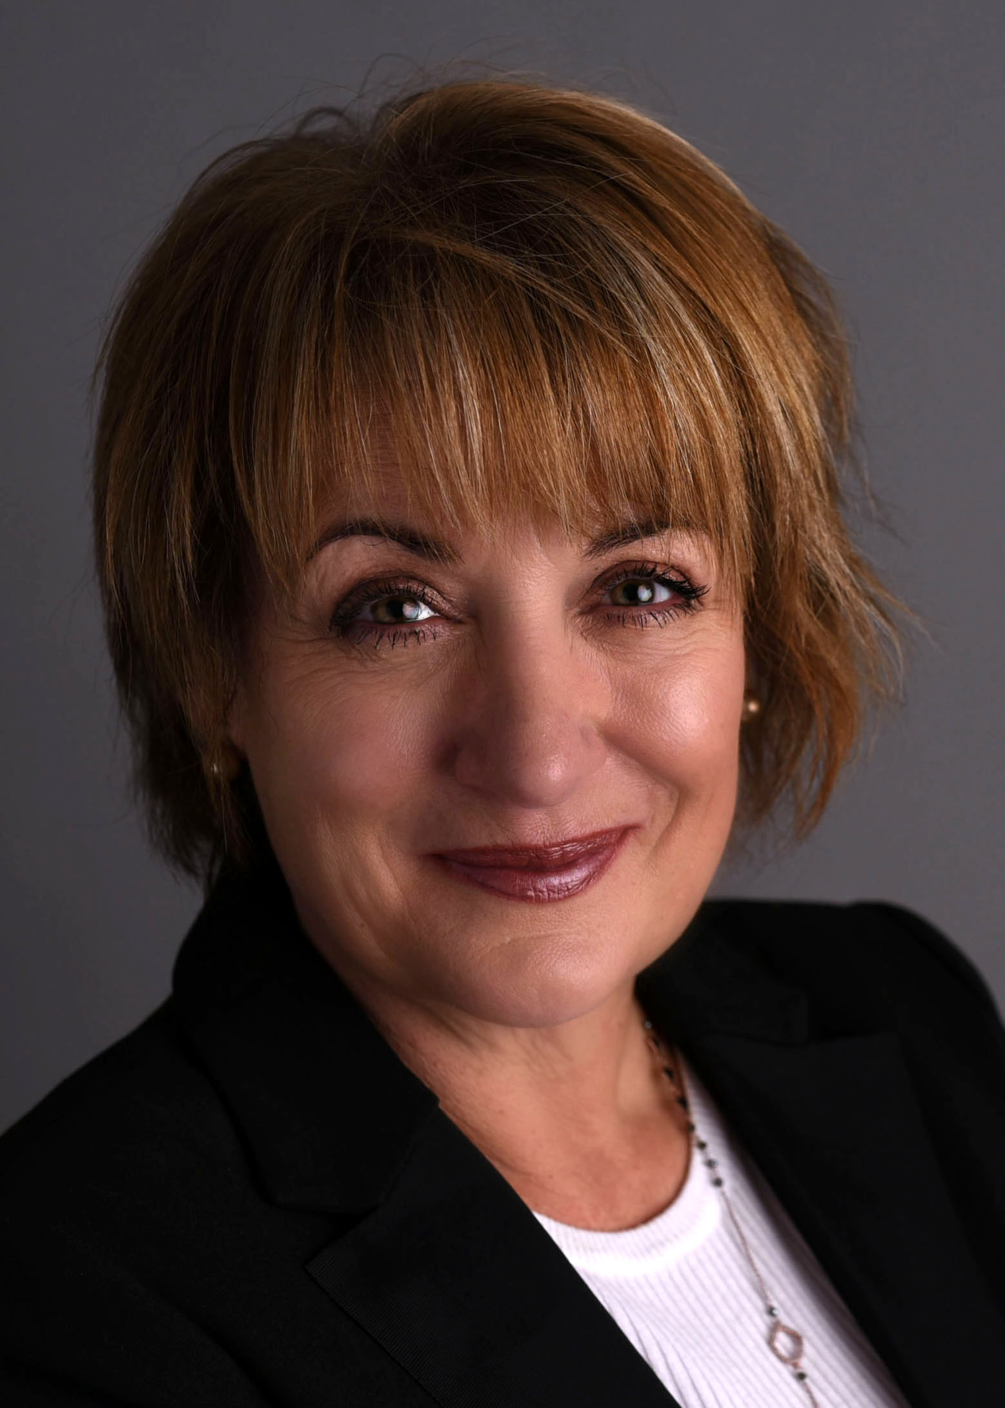

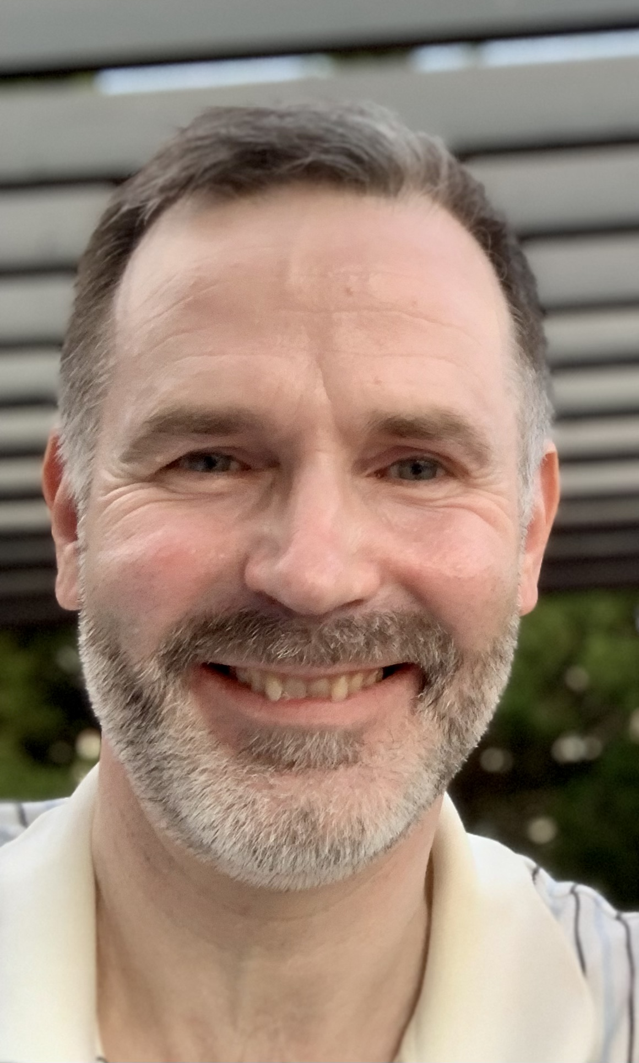
JM – Consulting. Who are we?
An HR and talent company offering advice and consultancy on either: large or small projects or as a day to day virtual
trusted HR advisor
Judith Moeckell
Talent specialist
Performance management
Senior talent assessments
Talent evaluation tools
Talent programmes
Maria Rzemieniecka
Global HR specialist
Restructures
Organisational design
Talent acquisition
Executive management
Timo Arokyla
Global HR generalist
Performance management
Remuneration
Building effective team
Change management

Slide 3
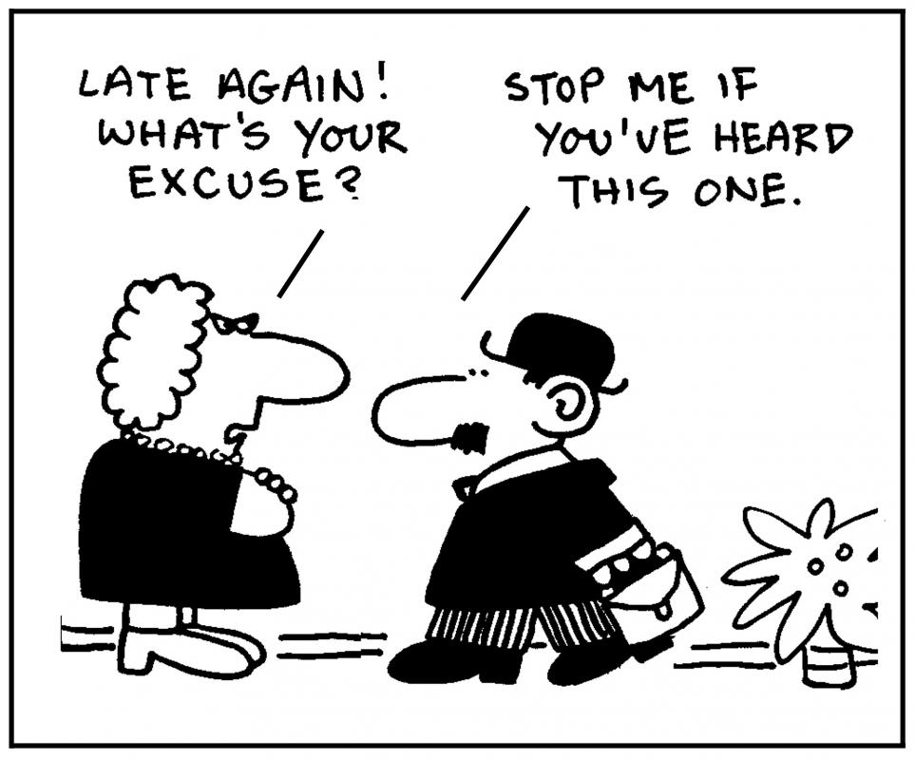
What is a challenging conversation?
Anything that someone does not want to talk about
Why not just avoid them?
Durable relationships
Strong sense of trust
Track record of surviving
Requisite to change & adaptation
Notes:
Everybody has them

Slide 4

Why do we hate challenging conversations
The brain tries to conserve energy. Difficult conversations consume energy because most people feel empathy or compassion for the other person
The brain thinks of responses to rebuttals, anger, embarrassment, sadness etc.
Nearly all people also want to be liked so avoid confrontation. People are usually reluctant to open a difficult conversation out of fear of the consequence
Notes:
We've all been there: We know we must talk to a colleague, our boss or even a friend about something we know will be at least uncomfortable and at worst explosive. So we repeatedly mull it over until we can no longer put it off, and then finally stumble through a confrontation when we could have had a conversation

Slide 5
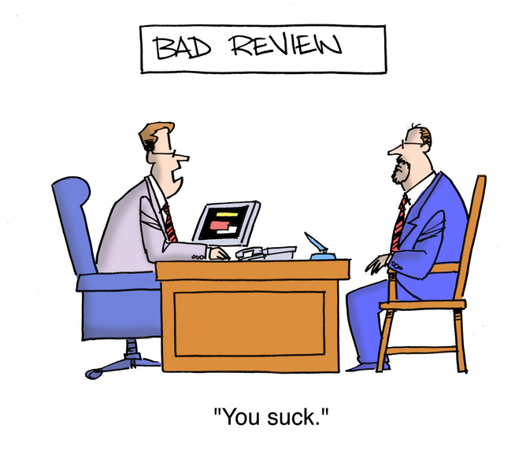



Examples of challenging workplace conversations
Performance
Behaviors
Personal hygiene,
Remuneration
Staff moves
Redundancy/exits
Development
Status (promotion, demotion, job title, office, desk…)

Slide 6




Four types of challenging conversation
1.
3.
2.
4.
‘What happened’?
Feelings!
Blame frame
Identity!
* Difficult conversations: Patton, Stone and Heen

Slide 7

How to manage honest and challenging conversations
Line managers guide to practical steps :
Prepare
Plan
Process
Post
JM Consulting Ltd
This Photo by Unknown Author is licensed under CC BY

Slide 8
Prepare
1.
Who is the right person to have the conversation?
What’s the purpose of the conversation?
What’s the right timing: Avoid times where the other person is unavailable for
follow up
Collect the facts
Anticipate the emotions in the room and how to keep yourself in control
Inform manager and HR, check policies
Outline an action plan: what happens next
This Photo by Unknown Author is licensed under CC BY

Slide 9
Plan
2.
Make sure the location is private
Face to face
Allow sufficient time – and you’re likely to need time to recover afterwards
How formal do you want the room layout to be
Think through what you want to say, how the other person may respond
What types of questions (open / closed / probing) you will ask
Think through what a successful conclusion looks like
This Photo by Unknown Author is licensed under CC BY

Slide 10

3.
4.
PROCESS
POST
Having the conversation
State your intention
Recognise & highlight positives
Seek your team member’s input
Ask open questions
Listen carefully
Check the information/objectives are
still correct
After the conversation
Record what was discussed & agreed.
Provide agreed follow up support
Have regular follow up progress meetings conversations

Slide 11

How to encourage a team culture of challenging conversations
Dig a ditch when it’s not raining: build trust
Encourage having the conversations sooner rather than later
Sometimes you don’t have to be liked
There is a simple way to start: ‘I see that X and Y are happening – why is that?’ Let the other person do most of the talking
Frame the conversation in a way as to solve an issue rather than blame someone
Being as direct as you can be will usually resolve the situation
Remind leaders that the outcome is almost always better than they expect
Be available for practice!
This Photo by Unknown Author is licensed under CC BY-SA

Slide 12

Difficult conversation 1
A contractor colleague cycles to work where they wash up at the toilet wash basin causing the floor to get wet AND the smell of sweat to linger in the toilet (and in the toilet.
A team member comes to HR asking them to have a conversation with the contractor.
(There is a shower facility and lockers in the office)

Slide 13

Difficult conversation 2
A team member in a highly successful team gets an average performance rating.
The team leader explains that they did a great job but that there were others whose performance was seen ‘more worthy’ and that the manager of the team leader wouldn’t allow ‘too many’ highest ratings.

Slide 14




JM Consulting Ltd https://www.jm-consulting.co.uk/
@jmconsultingltd
https://www.linkedin.com/company/jm--consulting-ltd
JM_consulting_ltd
Info@jm-consulting.co.uk

Slide 15
How to manage honest and challenging conversations
Line managers guide to
Performance conversations
& feedback
JM Consulting Ltd
This Photo by Unknown Author is licensed under CC BY

Slide 16
Its good to talk - Performance Discussions
1.
Preparing for the conversation
What is the purpose of the conversation
What facts and supporting materials do I need
How do we obtain the best possible outcome
3.
Completing the conversation
Ask if there are any other discussion points
Discuss development opportunities
Agree go forward actions
2.
Having the conversation
State your intention
Recognise & highlight positive performance
Seek your team members input
Ask open questions
Listen carefully
Check the performance objectives are still correct
4.
After the conversation
Record what was discussed & agreed.
Provide agreed follow up support
Have regular follow up progress meetings I.e. continuous performance management conversations

Slide 17

Examples of constructive feedback
1. Be Specific | You come across as dominating | I appreciate your ideas. It’s a shame this time it didn’t go to plan. Lets discuss what didn’t work & how we can learn for the future
2. Behaviour not person | In the meeting you were a loudmouth | You may have got more of the information you needed if you had asked for opinions & comments
3. Help not hurt | If you had listened to me this would have worked out | I value your ideas, and know you were excited to talk. It’s important to also give space to others so that we can learn from their ideas too
Y

Slide 18

Feedback hints and tips
Include praise as well as areas to improve
Focus on observable behaviour not assumptions
Keep feedback factual and specific
Use reinforcing feedback:
Acknowledge good practices & the positive
Behaviours your team member should continue
Developmental feedback: use to encourage a change or
improvement in a situation or behaviours:
Use examples that are clear and understandable
Use feedback from your own observations not those of a
third party
Give feedback in the right environment and one of trust
Provide recommendations and actions

